Slide 1



Introduction
Business Problem:
Netflix Company wants to find out which movies/shows has to be produced more to attract customers and increase the sales.

Slide 2

Solution Expected
The insights from a given data to target the audience and increase the sales or subscriptions based on the Type

Slide 3

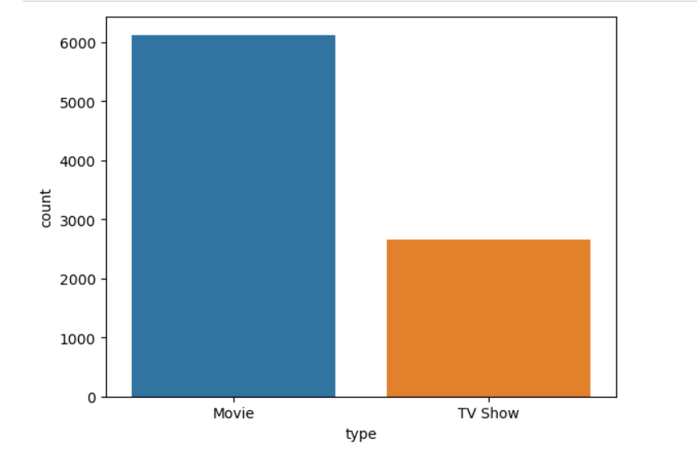
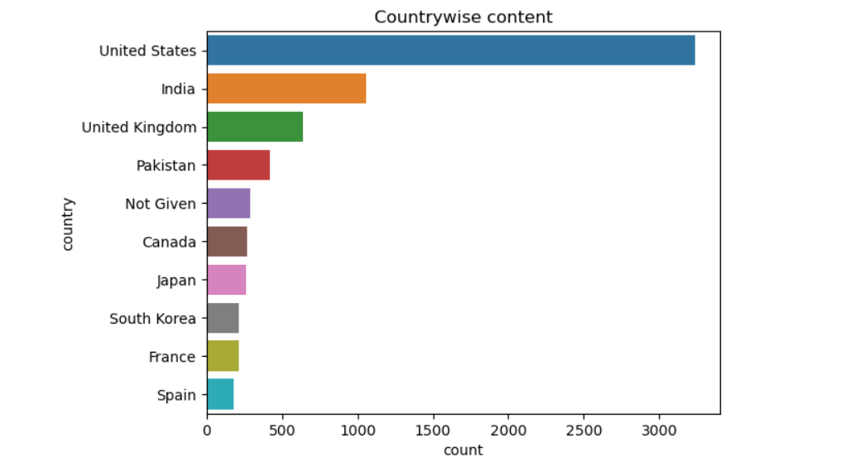
Data was collected from Netfix data set for a period of 20 years and the analysis was done on the region,Type,genre and many other parameters

Slide 4


Insights and recommendations
1.Netflix has more Movies than Tv Shows
2.Most number of Tv Shows are produced By United States Followed by India at the Second Place.
3.Most Movies and tv Shows has been released during 2018
4.International Movies and Dramas are most popular in Netflix
5. Most of the Shows has a rating of TV-MA which is for Mature Audience

Slide 5

Thank You!
Presenter: Shaik Meeran Khaleel

